Slide 1
Applied Cryptography the index calculus method, digital signature, RSA signature, KOA, KMA, CMA, total break, selective forgery, existential forgery
Liangfeng Zhang
School of Information Science and Technology
ShanghaiTech University

Slide 2
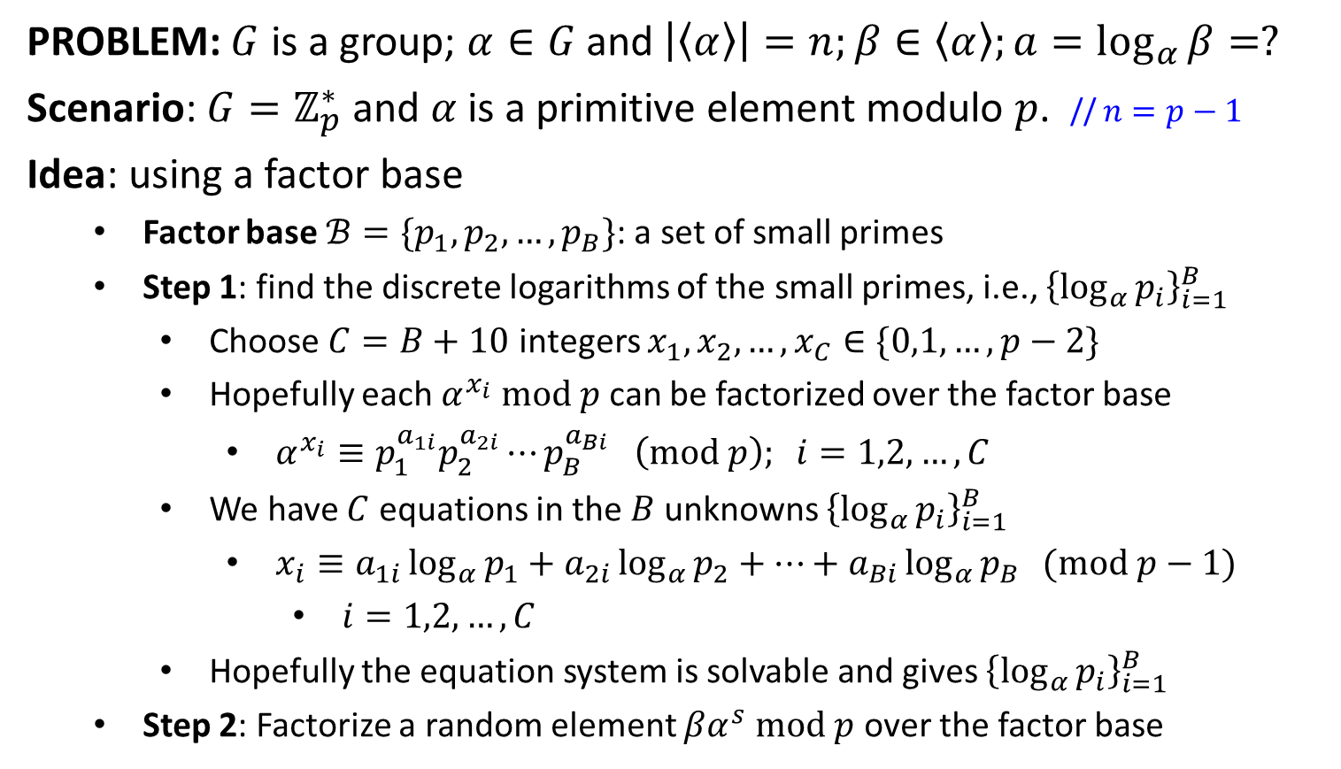
The Index Calculus Method (1986)
PROBLEM: $G$ is a group; $α∈G$ and $\left|〈α〉\right|=n;β∈〈α〉;a=\log_{α}{β}=?$
Scenario: $G=ℤ_{p}^{∗}$ and $α$ is a primitive element modulo $p$. // $n=p−1$
Idea: using a factor base
Factor base $ℬ=\{p_{1},p_{2},…,p_{B}\}$: a set of small primes
Step 1: find the discrete logarithms of the small primes, i.e., ${\left\{\log_{α}{p_{i}}\right\}}_{i=1}^{B}$
Choose $C=B+10$ integers $x_{1},x_{2},…,x_{C}∈\{0,1,…,p−2\}$
Hopefully each $α^{x_{i}} mod p$ can be factorized over the factor base
$α^{x_{i}}≡p_{1}^{a_{1i}}p_{2}^{a_{2i}}⋯p_{B}^{a_{Bi}} \left(mod p\right); i=1,2,…,C$
We have $C$ equations in the $B$ unknowns ${\left\{\log_{α}{p_{i}}\right\}}_{i=1}^{B}$
$x_{i}≡a_{1i}\log_{α}{p_{1}}+a_{2i}\log_{α}{p_{2}}+⋯+a_{Bi}\log_{α}{p_{B}} (mod p−1)$
$i=1,2,…,C$
Hopefully the equation system is solvable and gives ${\left\{\log_{α}{p_{i}}\right\}}_{i=1}^{B}$
Step 2: Factorize a random element $βα^{s} mod p$ over the factor base

Slide 3
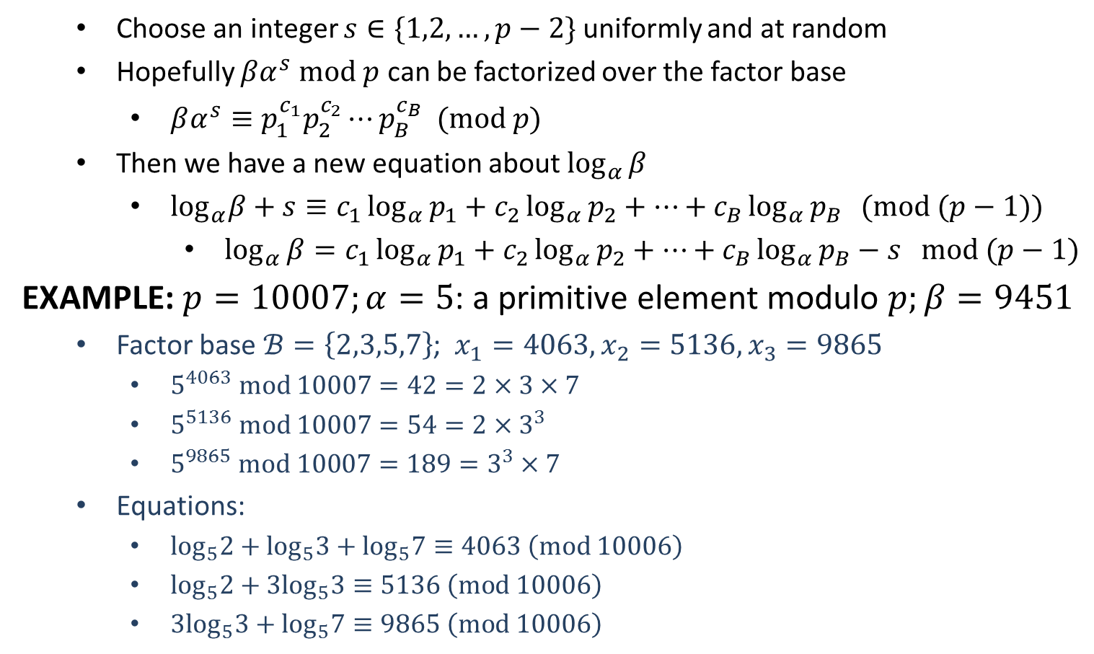
The Index Calculus Method
Choose an integer $s∈\{1,2,…,p−2\}$ uniformly and at random
Hopefully $βα^{s} mod p$ can be factorized over the factor base
$βα^{s}≡p_{1}^{c_{1}}p_{2}^{c_{2}}⋯p_{B}^{c_{B}} (mod p)$
Then we have a new equation about $\log_{α}{β}$
$\log_{α}β+s≡c_{1}\log_{α}{p_{1}}+c_{2}\log_{α}{p_{2}}+⋯+c_{B}\log_{α}{p_{B}} (mod (p−1))$
$\log_{α}{β}=c_{1}\log_{α}{p_{1}}+c_{2}\log_{α}{p_{2}}+⋯+c_{B}\log_{α}{p_{B}}−s mod (p−1)$
EXAMPLE: $p=10007;α=5$: a primitive element modulo $p;β=9451$
Factor base $ℬ=\left\{2,3,5,7\right\}$; $x_{1}=4063, x_{2}=5136, x_{3}=9865$
$5^{4063} mod 10007=42=2×3×7$
$5^{5136} mod 10007=54=2×3^{3}$
$5^{9865} mod 10007=189=3^{3}×7$
Equations:
$\log_{5}2+\log_{5}3+\log_{5}7≡4063 \left(mod 10006\right)$
$\log_{5}2+3\log_{5}3≡5136 \left(mod 10006\right)$
$3\log_{5}3+\log_{5}7≡9865 \left(mod 10006\right)$
$$\log_{5}2=6578; \log_{5}3=6190; \log_{5}7=1301$$

Slide 4
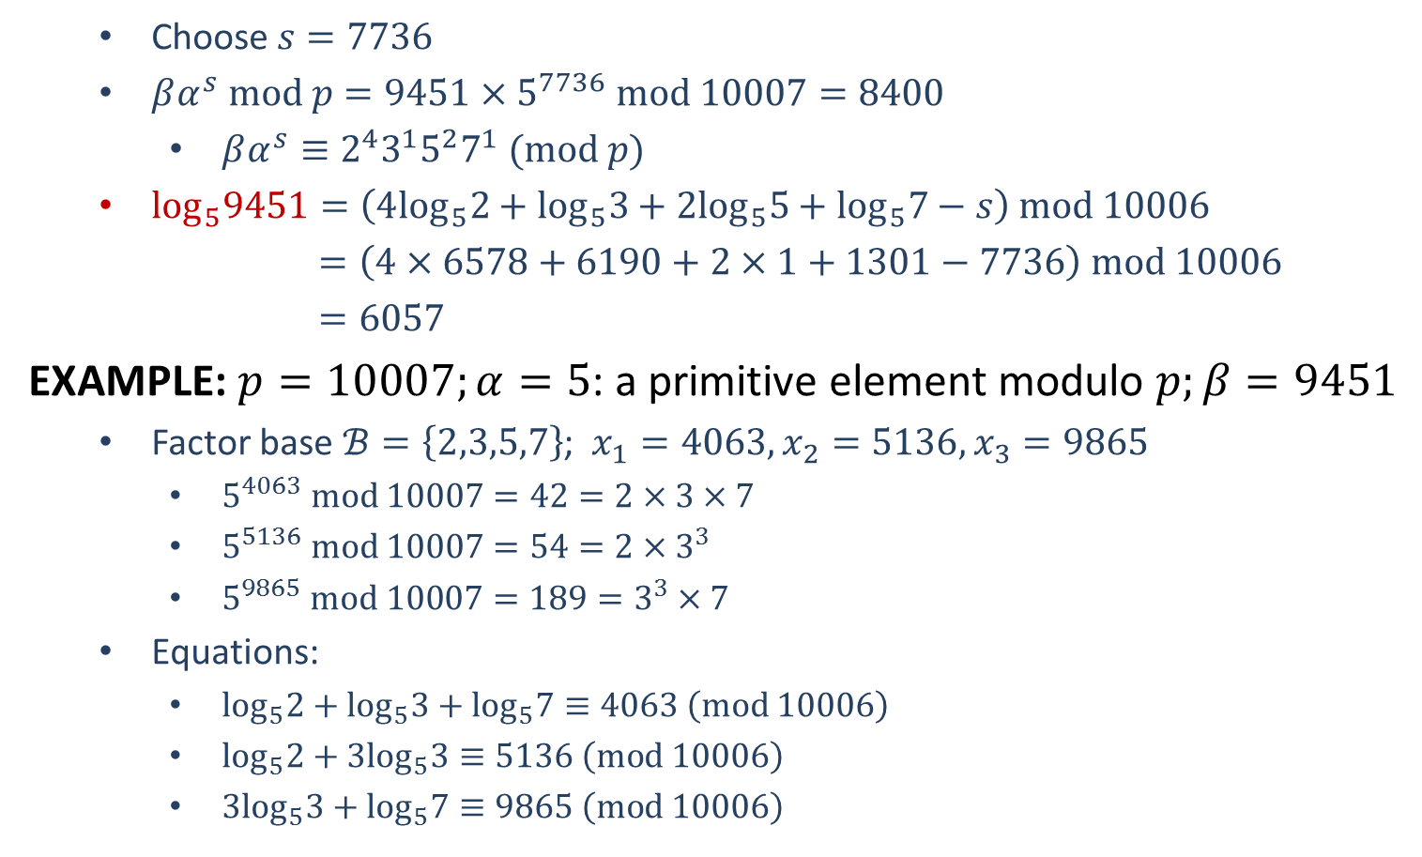
The Index Calculus Method
Choose $s=7736$
$βα^{s} mod p=9451×5^{7736} mod 10007=8400$
$βα^{s}≡2^{4}3^{1}5^{2}7^{1} (mod p)$
$\log_{5}9451=\left(4\log_{5}2+\log_{5}3+2\log_{5}5+\log_{5}7−s\right) mod 10006$
$=\left(4×6578+6190+2×1+1301−7736\right) mod 10006$
$=6057$
EXAMPLE: $p=10007;α=5$: a primitive element modulo $p;β=9451$
Factor base $ℬ=\left\{2,3,5,7\right\}$; $x_{1}=4063, x_{2}=5136, x_{3}=9865$
$5^{4063} mod 10007=42=2×3×7$
$5^{5136} mod 10007=54=2×3^{3}$
$5^{9865} mod 10007=189=3^{3}×7$
Equations:
$\log_{5}2+\log_{5}3+\log_{5}7≡4063 \left(mod 10006\right)$
$\log_{5}2+3\log_{5}3≡5136 \left(mod 10006\right)$
$3\log_{5}3+\log_{5}7≡9865 \left(mod 10006\right)$
$$\log_{5}2=6578; \log_{5}3=6190; \log_{5}7=1301$$

Slide 5
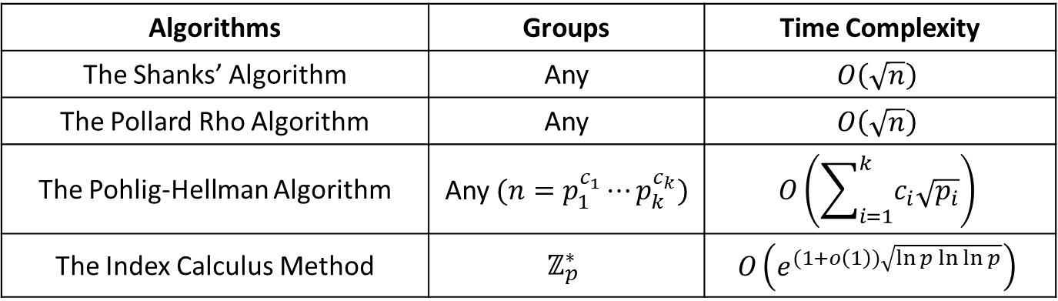
Complexity
Algorithms | Groups | Time Complexity
The Shanks’ Algorithm | Any | $$O\left(\sqrt{n}\right)$$
The Pollard Rho Algorithm | Any | $$O\left(\sqrt{n}\right)$$
The Pohlig-Hellman Algorithm | Any $(n=p_{1}^{c_{1}}⋯p_{k}^{c_{k}})$ | $$O\left(\sum_{i=1}^{k}{c_{i}\sqrt{p_{i}}}\right)$$
The Index Calculus Method | $$ℤ_{p}^{∗}$$ | $$O\left(e^{(1+o\left(1\right))\sqrt{\ln{p}\ln{\ln{p}}}}\right)$$

Slide 7
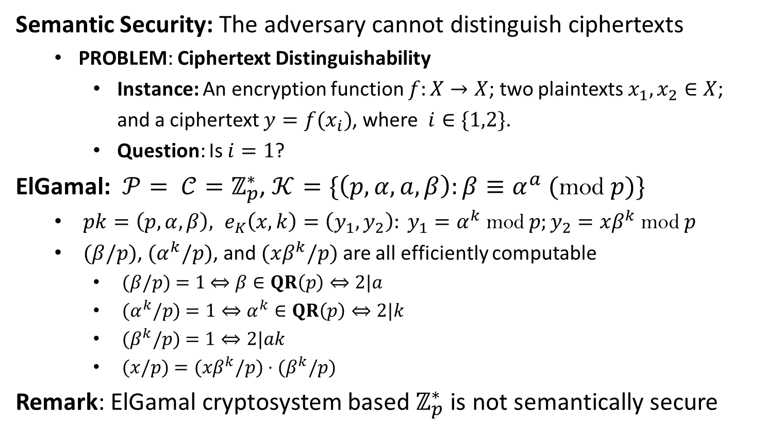
Semantic Security of ElGamal
Semantic Security: The adversary cannot distinguish ciphertexts
PROBLEM: Ciphertext Distinguishability
Instance: An encryption function $f:X→X$; two plaintexts $x_{1},x_{2}∈X$;
and a ciphertext $y=f(x_{i})$, where $i∈\{1,2\}$.
Question: Is $i=1$?
ElGamal: $𝒫= 𝒞=ℤ_{p}^{∗}$, $𝒦=\{\left(p,α,a,β\right):β≡α^{a}\text{ (}\text{mod} p)\}$
$pk=\left(p,α,β\right), e_{K}\left(x,k\right)=\left(y_{1},y_{2}\right): y_{1}=α^{k} \text{mod} p;y_{2}=xβ^{k} \text{mod} p$
$(β/p)$, $(α^{k}/p)$, and $(xβ^{k}/p)$ are all efficiently computable
$(β/p)$ $=1$ $⇔β∈QR\left(p\right)⇔2|a$
$(α^{k}/p)$ $=1⇔α^{k}∈QR\left(p\right)⇔2|k$
$(β^{k}/p)$ $=1⇔2|ak$
$(x/p)$ $=(xβ^{k}/p)$ $⋅(β^{k}/p)$
Remark: ElGamal cryptosystem based $ℤ_{p}^{∗}$ is not semantically secure

Slide 8
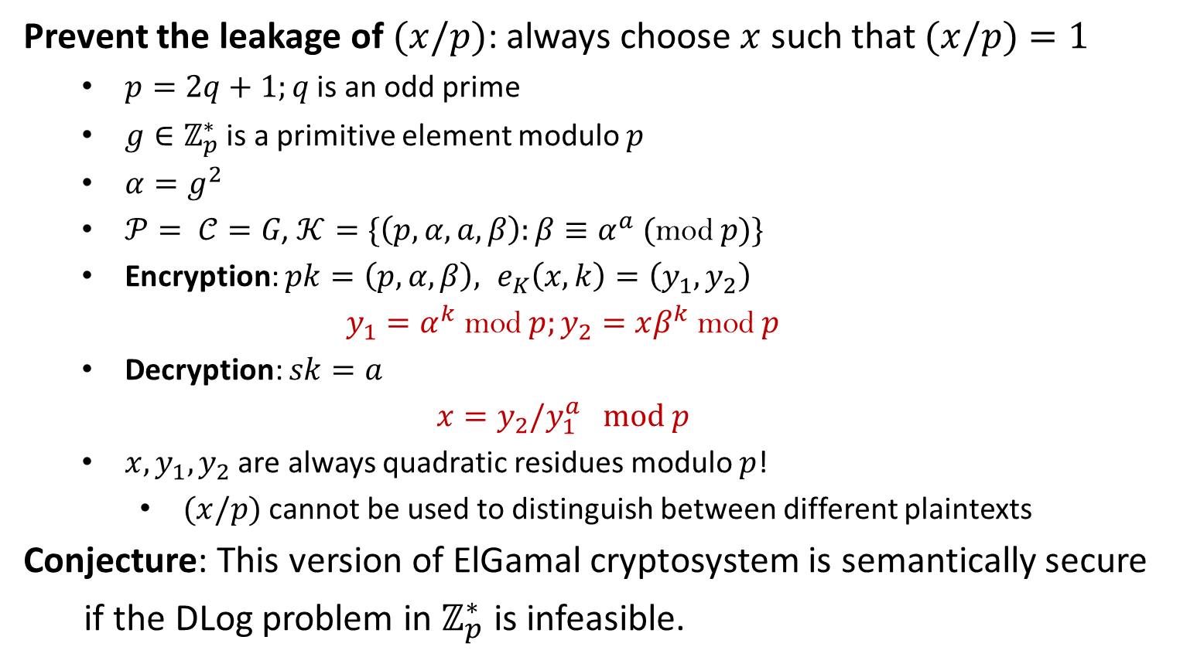
Semantic Security of ElGamal
Prevent the leakage of $(x/p)$: always choose $x$ such that $(x/p)$ $=1$
$p=2q+1;q$ is an odd prime
$g∈ℤ_{p}^{∗}$ is a primitive element modulo $p$
$α=g^{2}$
$𝒫= 𝒞=G\text{, }𝒦=\{\left(p,α,a,β\right):β≡α^{a}\text{ (}\text{mod} p)\}$
Encryption: $pk=\left(p,α,β\right), e_{K}\left(x,k\right)=\left(y_{1},y_{2}\right)$
$$y_{1}=α^{k} \text{mod} p;y_{2}=xβ^{k} \text{mod} p$$
Decryption: $sk=a$
$$x=y_{2}/y_{1}^{a} mod p$$
$x,y_{1},y_{2}$ are always quadratic residues modulo $p$!
$(x/p)$ cannot be used to distinguish between different plaintexts
Conjecture: This version of ElGamal cryptosystem is semantically secure
if the DLog problem in $ℤ_{p}^{∗}$ is infeasible.

Slide 10


Integrity
“Transfer $10000 from Alice to Charlie”
Alice
Bob (bank)
Charlie
The property that sensitive data has not been modified or deleted in an unauthorized and undetected manner.
FIPS 140-2
Chapter 5: Hash Functions and Message Authentication
Chapter 8: Signature Schemes

Slide 11
Non-Repudiation
“Transfer $1000 from Alice to David”
$$I never send this instruction‼!$$
Alice
Bob (bank)
$$I never receive this instruction‼!$$
Assurance that the sender of information is provided with proof of delivery and the recipient is provided with proof of the sender’s identity, so neither can later deny having processed the information.
CNSSI-4009; SP 800-60
Chapter 8: Signature Schemes
Other (Advanced) topics?

Slide 13
Signatures: Conventional vs. Digital
Conventional Signature: A handwritten string attached to a document
Part of the physical document that is being signed
Transmitted physically
Verified by comparing with the authentic signatures
A copy of the signed paper document is easily distinguished from an original
Digital Signature: A string in electronic form
Not physically attached to the message that is being signed
Transmitted over computer networks
Verified by a publicly known verification algorithm
A copy of the signed digital message is identical to the original
Replay attack: A signed message may be easily replayed

Slide 14
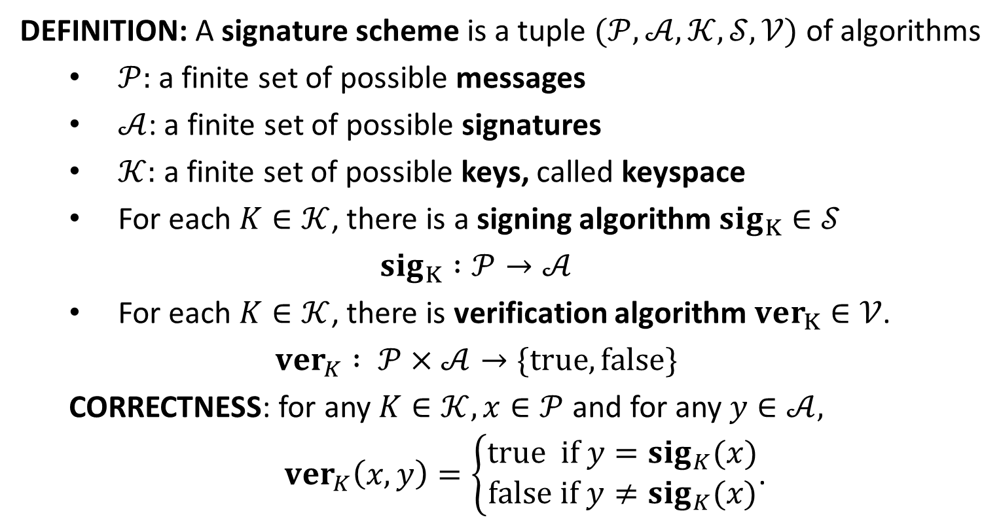
(Digital) Signature Scheme
DEFINITION: A signature scheme is a tuple $(𝒫,𝒜,𝒦,𝒮,𝒱)$ of algorithms
$𝒫:$ a finite set of possible messages
$𝒜$: a finite set of possible signatures
$𝒦:$a finite set of possible keys, called keyspace
For each $K∈𝒦$, there is a signing algorithm $sig_{K}∈𝒮$
$$sig_{K} :𝒫→𝒜$$
For each $K∈𝒦$, there is verification algorithm $ver_{K}∈𝒱$.
$$ver_{K} : 𝒫×𝒜→\{true, false\}$$
CORRECTNESS: for any $K∈𝒦,x∈𝒫$ and for any $y∈𝒜,$
$ver_{K}\left(x,y\right)=\left\{\begin{aligned}true if y=sig_{K}(x) \\ false if y≠sig_{K}(x)\end{aligned}\right.$.

Slide 15
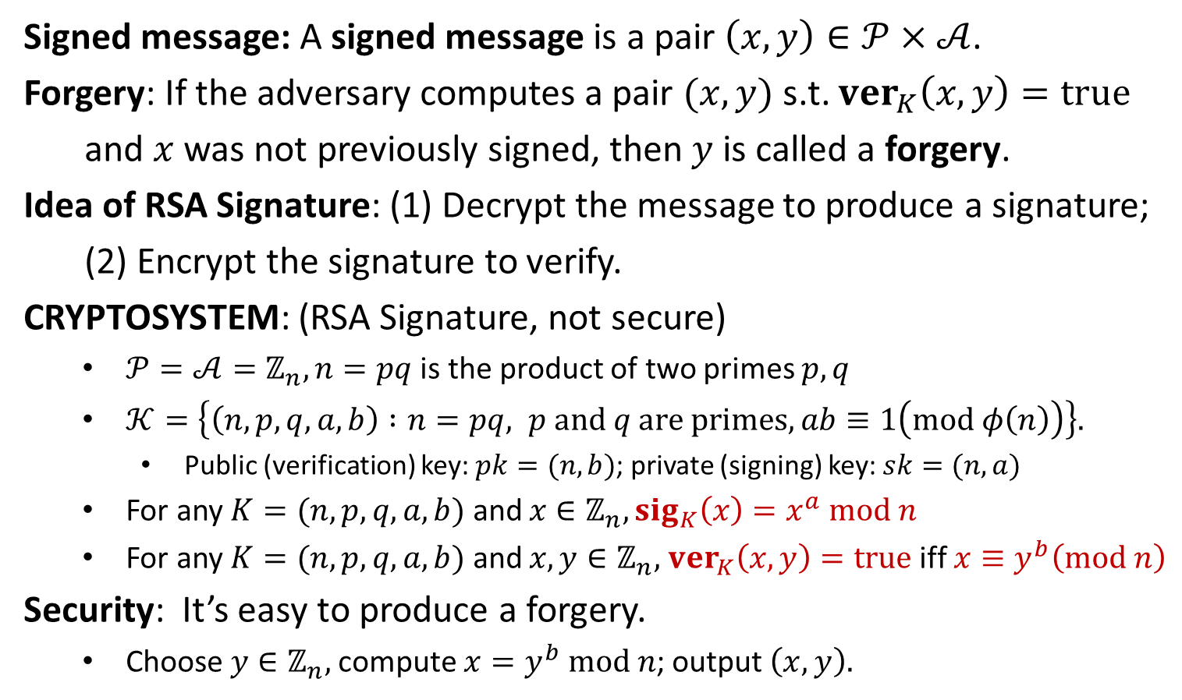
RSA Signature
Signed message: A signed message is a pair $\left(x,y\right)∈𝒫×𝒜$.
Forgery: If the adversary computes a pair $(x, y)$s.t. $ver_{K}\left(x,y\right)=true$
and $x$ was not previously signed, then $y$is called a forgery.
Idea of RSA Signature: (1) Decrypt the message to produce a signature;
(2) Encrypt the signature to verify.
CRYPTOSYSTEM: (RSA Signature, not secure)
$𝒫=𝒜=ℤ_{n}, n=pq$ is the product of two primes $p,q$
$𝒦=\left\{\left(n,p,q,a,b\right) :n=pq, p and q are primes, ab≡1\left(mod φ\left(n\right)\right)\right\}.$
Public (verification) key: $pk=(n,b)$; private (signing) key: $sk=(n,a)$
For any $K=(n,p,q,a,b)$ and $x∈ℤ_{n}, sig_{K}\left(x\right)=x^{a} mod n$
For any $K=(n,p,q,a,b)$ and $x,y∈ℤ_{n},$ $ver_{K}\left(x,y\right)=true$ iff $x≡y^{b}\left(mod n\right)$
Security: It’s easy to produce a forgery.
Choose $y∈ℤ_{n},$compute $x=y^{b} mod n$; output $\left(x,y\right).$

Slide 17
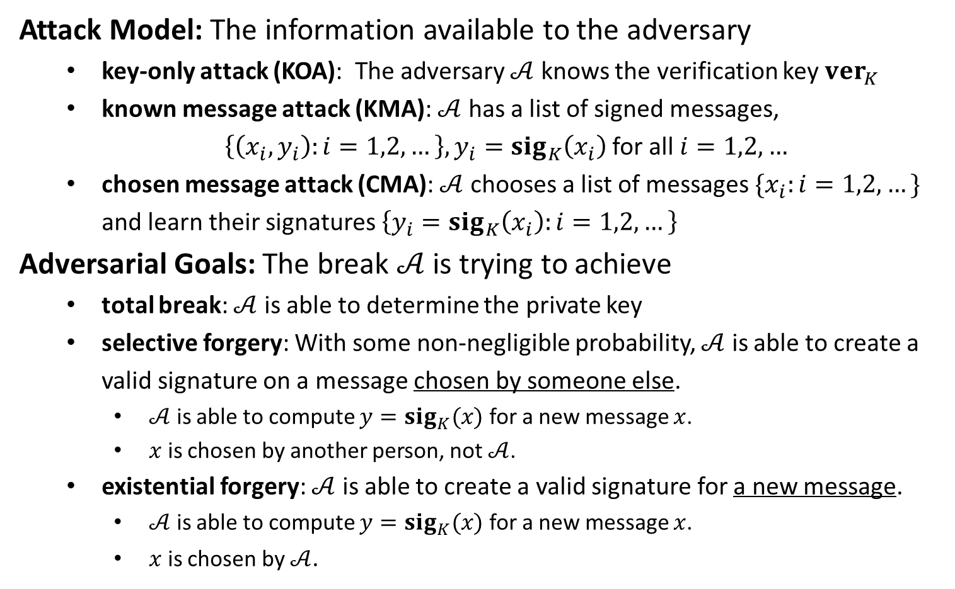
Security Model
Attack Model: The information available to the adversary
key-only attack (KOA): The adversary $𝒜$ knows the verification key $ver_{K}$
known message attack (KMA): $𝒜$ has a list of signed messages,
$\left\{\left(x_{i},y_{i}\right):i=1,2,…\right\},y_{i}=sig_{K}\left(x_{i}\right)$ for all $i=1,2,…$
chosen message attack (CMA): $𝒜$ chooses a list of messages $\{x_{i}:i=1,2,…\}$ and learn their signatures $\left\{y_{i}=sig_{K}\left(x_{i}\right):i=1,2,…\right\}$
Adversarial Goals: The break $𝒜$ is trying to achieve
total break: $𝒜$ is able to determine the private key
selective forgery: With some non-negligible probability, $𝒜$ is able to create a valid signature on a message chosen by someone else.
$𝒜$ is able to compute $y=sig_{K}(x)$ for a new message $x$.
$x$ is chosen by another person, not $𝒜$.
existential forgery: $𝒜$ is able to create a valid signature for a new message.
$𝒜$ is able to compute $y=sig_{K}(x)$ for a new message $x$.
$x$ is chosen by $𝒜$.

Slide 18
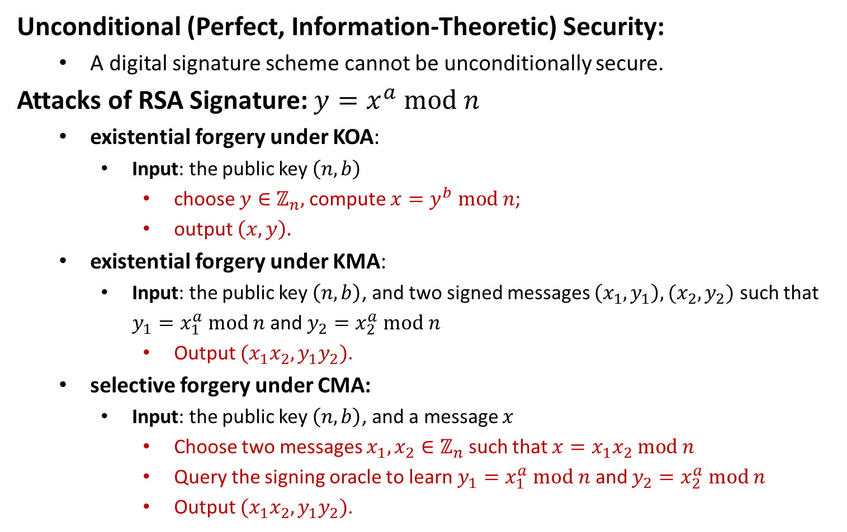
Security Model
Unconditional (Perfect, Information-Theoretic) Security:
A digital signature scheme cannot be unconditionally secure.
Attacks of RSA Signature: $y=x^{a} mod n$
existential forgery under KOA:
Input: the public key $\left(n,b\right)$
choose $y∈ℤ_{n},$compute $x=y^{b} mod n$;
output $\left(x,y\right).$
existential forgery under KMA:
Input: the public key $\left(n,b\right)$, and two signed messages $\left(x_{1},y_{1}\right), (x_{2},y_{2})$ such that $y_{1}=x_{1}^{a} mod n$ and $y_{2}=x_{2}^{a} mod n$
Output $(x_{1}x_{2}, y_{1}y_{2})$.
selective forgery under CMA:
Input: the public key $\left(n,b\right)$, and a message $x$
Choose two messages $x_{1},x_{2}∈ℤ_{n}$ such that $x=x_{1}x_{2} mod n$
Query the signing oracle to learn $y_{1}=x_{1}^{a} mod n$ and $y_{2}=x_{2}^{a} mod n$
Output $(x_{1}x_{2}, y_{1}y_{2})$.

